Slide 1
Iris Recognition Using PCA and Fischer LDA
-Aniket Bhatia
-shubhang bhatnagar
-vineet Ashok kotariyA

Slide 2
Block Diagram
Preprocessing
PCA Decomposition
Fischer Linear Discriminant analysis (LDA)
Training
Dataset
Best Match Algorithm
PCA + LDA Decomposition
Testing
Dataset
Recognition/
Error calculation

Slide 3
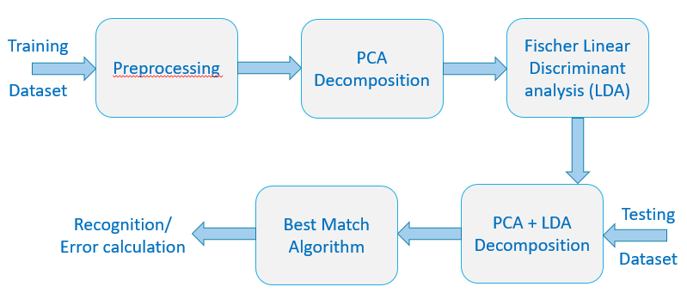
Preprocessing
No Preprocessing of data
Enhanced Dataset images
Normalization of Dataset images
Occlusion Removal of Normalized images
Remove the complete right half
Eyelash Detection and Removal

Slide 4
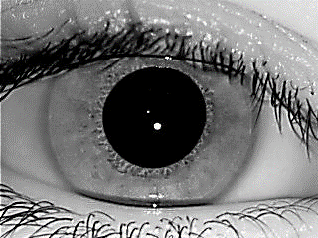
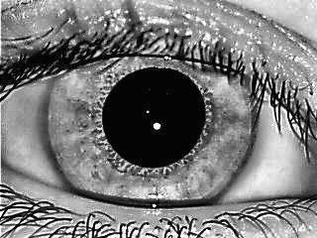
Enhancement of the Images
AHE

Slide 5
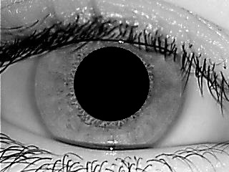
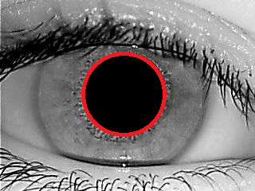
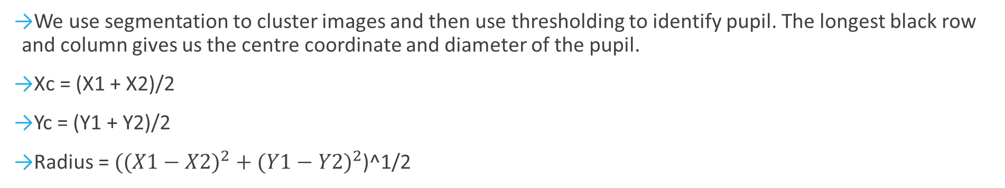
Normalization of the Images
Pupil
Segmentation
We use segmentation to cluster images and then use thresholding to identify pupil. The longest black row and column gives us the centre coordinate and diameter of the pupil.
Xc = (X1 + X2)/2
Yc = (Y1 + Y2)/2
Radius = $(({X1−X2)}^{2}+({Y1−Y2)}^{2}$)^1/2

Slide 6
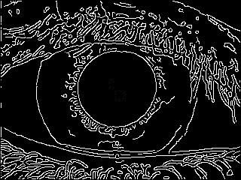
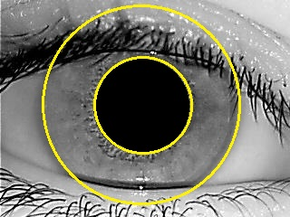
Normalization(Contd.)
Edge Detection
Hough Transform
Convert to (r,θ)
We use “Canny” Edge detection to demarcate a rough boundary circle for the Iris
Hough transform is then used to get the outer radius of the iris (and outer radius of the pupil)
We convert the image between the two radii into (r,θ) format to get the “Rubber Sheet model” or the Normalized Image.

Slide 7


Occlusion Removal
Keep left Side of Normalized Image only
Here we do get rid of a major portion the irrelevant features, but we also lose some desired features
Eyelash Detection and Removal
Here we detect the outline of the eyelash and try to remove it, hence trying to preserve the relevant data.
This mask is for the detected eyelash (on the right) and was multiplied with the original image to remove the effect of the eyelashes

Slide 8
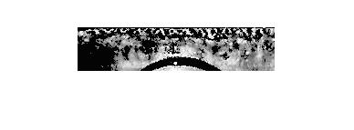


Left Side of Normalized Image + Median Filter+CLAHE

Slide 9
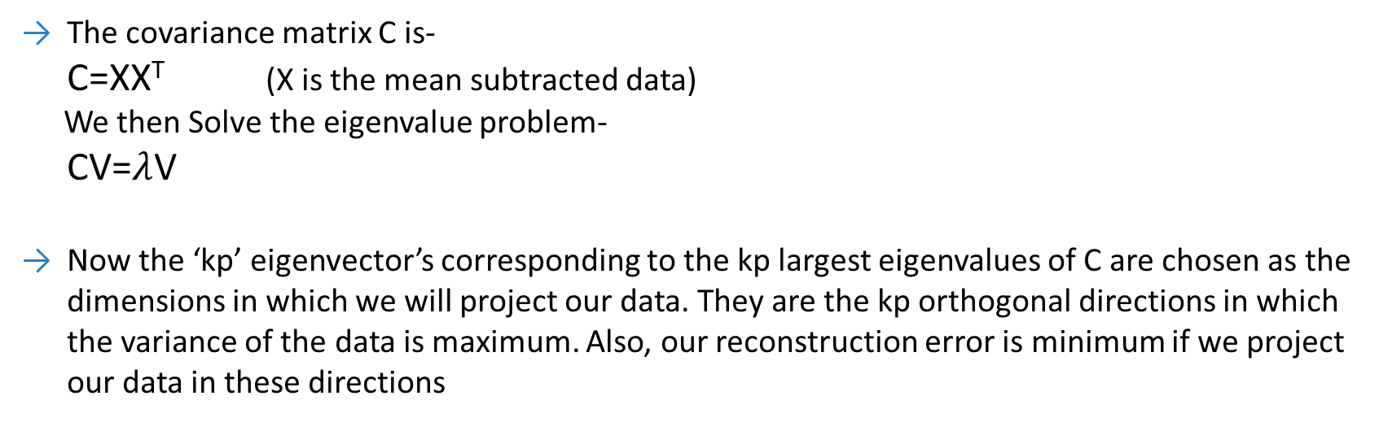
Principal Component Analysis (PCA)
PCA is an algorithm which is used to effectively reduce the dimensionality of the input data. This is achieved by first getting the covariance matrix of the data and then getting its eigenvectors.
The covariance matrix C is-
C=XX^{T} (X is the mean subtracted data)
We then Solve the eigenvalue problem-
CV=$λ$V
Now the ‘kp’ eigenvector’s corresponding to the kp largest eigenvalues of C are chosen as the dimensions in which we will project our data. They are the kp orthogonal directions in which the variance of the data is maximum. Also, our reconstruction error is minimum if we project our data in these directions

Slide 10
Benefits of using PCA before LDA
It helps reduce the dimensionality of the input data to the LDA so that the LDA can work faster with a reduced number of dimensions. It also helps to filter out the data to give only the important features only.
Also PCA is critical in the fisher ‘iris’ algorithm as the within the class scatter matrix Sw of LDA becomes almost singular if the dimensions of the input to it is much higher than the number of training examples given to it (if d>>n). This is a problem as we need to calculate inverse(Sw) in the LDA algorithm. To overcome this, we project our data to a lower dimensional sub space which is given by PCA

Slide 11
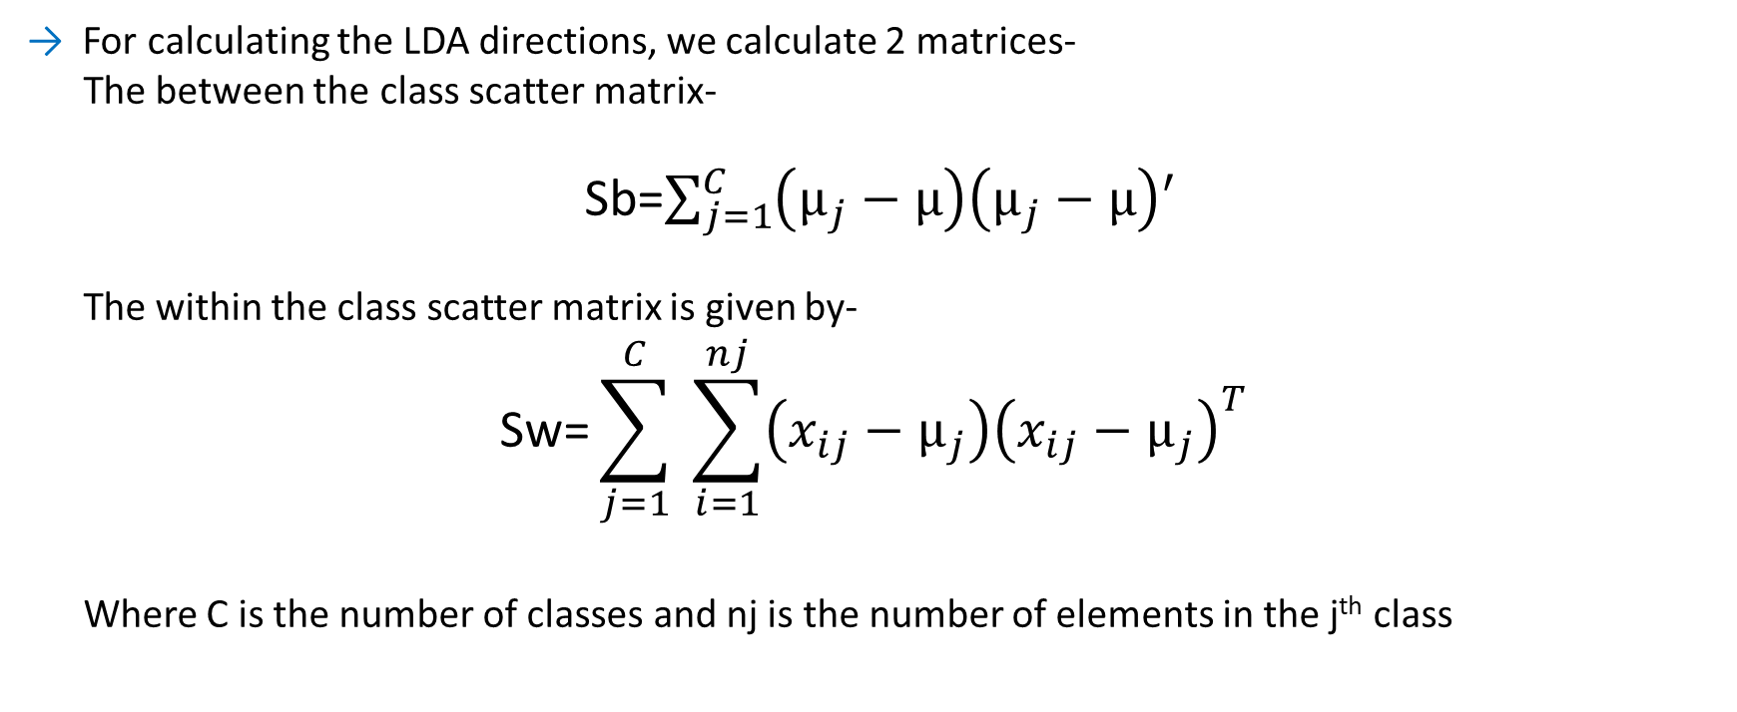
Linear Discriminant Analysis (LDA)
LDA is a supervised classification algorithm, with a linear decision boundary (hence the name). It too involves getting a set of directions (like PCA) in which we project the data. It is better than PCA as it considers the class labels of data in getting the best directions for projecting the data.
For calculating the LDA directions, we calculate 2 matrices-
The between the class scatter matrix-
Sb=$\sum_{j=1}^{C}{\left(µ_{j}−µ\right)\left(µ_{j}−µ\right)′}$
The within the class scatter matrix is given by-
$$\text{S}\text{w}\text{=}\sum_{j=1}^{C}{ \sum_{i=1}^{nj}{{\left({x_{ij}−µ}_{j}\right)\left({x_{ij}−µ}_{j}\right)}^{T}}}$$
Where C is the number of classes and nj is the number of elements in the j^{th} class

Slide 12
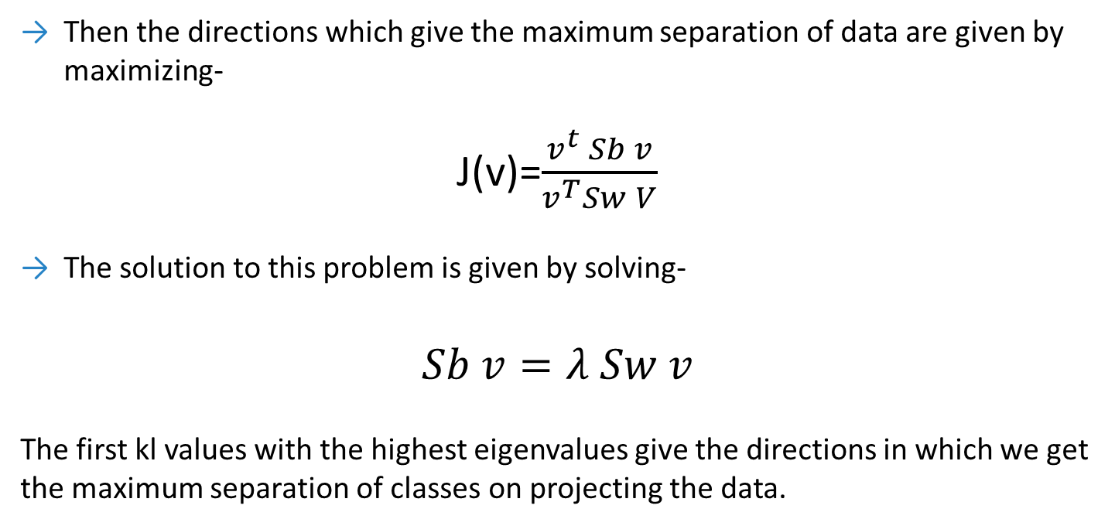
Then the directions which give the maximum separation of data are given by maximizing-
J(v)=$\frac{v^{t} Sb v}{v^{T}Sw V}$
The solution to this problem is given by solving-
$$Sb v=λ Sw v$$
The first kl values with the highest eigenvalues give the directions in which we get the maximum separation of classes on projecting the data.

Slide 13
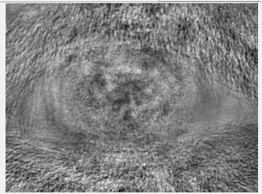
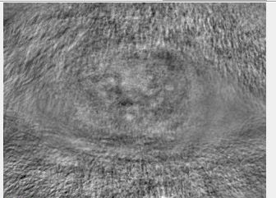
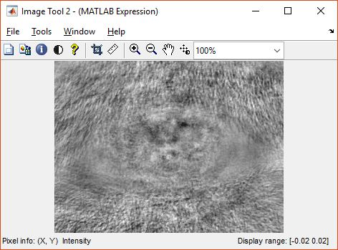
Fisher Iris 1
Fisher Iris 2
Fisher Iris 3
The LDA eigenvectors which we get are called Fisher Iris and represent the direction’s
After getting the set of directions, we project our training data in this direction to get a set of coefficient's (of the LDA directions) . This set of coefficients is compared with the test inputs coefficients to give the correct output class for the test data.

Slide 14
Testing and Matching
In the fisher iris algorithm we perform LDA on the reduced dimension representation of the training dataset to get the LDA vectors. So, for testing too we have to we follow:
Calculate the PCA eigenvector’s coefficients for the mean subtracted test input.
Calculate the LDA eigenvector’s coefficients for the calculated PCA eigenvectors of the test data.
We compare the test inputs with the stored training data’s LDA coefficients and select the training sample which is the closest in terms of Euclidean distance to the test input.
Also, if the distance between the nearest training sample and the test input is too high (determined through hit and try) we reject the input and give a null match.

Slide 15
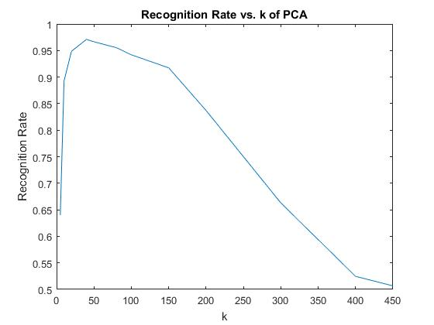
Unprocessed Training Data
The Dataset was used as it is without any pre-processing on it
As the k increases the recognition rate decreases sharply.
For smaller k only the desired “features” with higher spread (important ones) are included. (Iris has maximum variance)
The extra (undesired) features (Eyelashes/pupil etc.) when included more, due to higher k , begin to dominate and the accuracy plummets
Maximum Accuracy : 97.10%

Slide 16
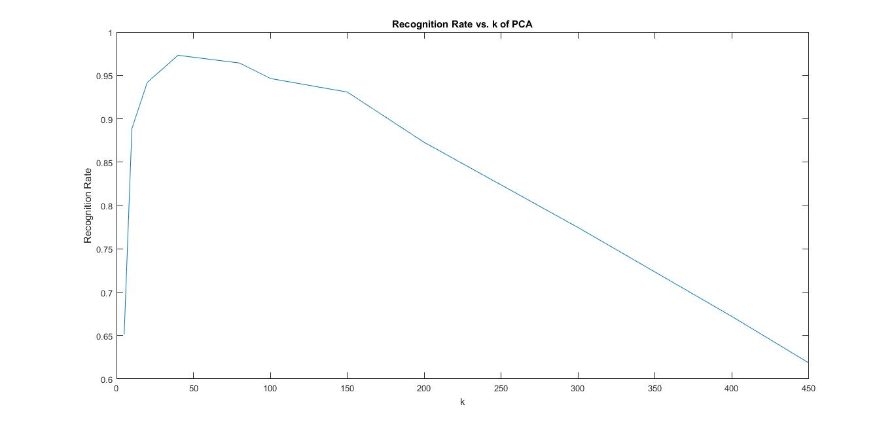
Median Filtered Training Data
Maximum Accuracy : 97.32%

Slide 17
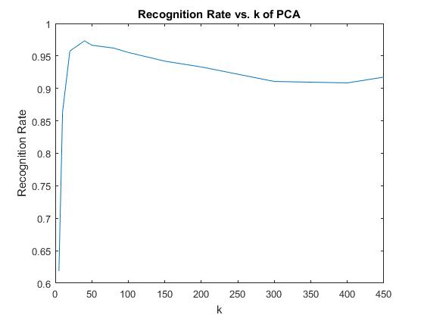
Normalized Training Data
Each image was transformed into a “Rubber sheet” model of itself.
Only the Iris had to be “extracted” from each image. Segmentation, thresholding, inversion, edge detection and Hough transform have to be used to achieve that.
A lot of undesired features are removed and only the significant “information is retained”. This is why it gives us a higher recognition rate than unprocessed images.
Maximum Accuracy : 97.32%

Slide 18
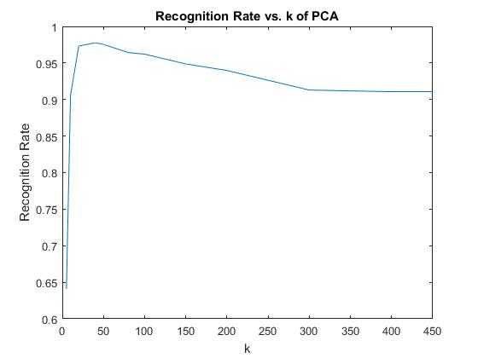
Right Half-Removed Normalized Training Data
θϵ(π,2π] is contains the eyelashes almost completely.
And its removal gives us a higher recognition rate than unprocessed images as the undesired information is removed.
However, it removes some of the relevant data as well
Maximum Accuracy : 97.70%

Slide 19
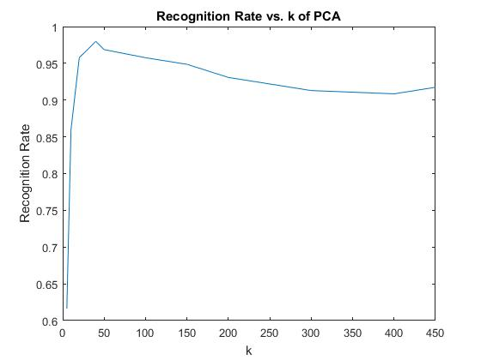
Eyelash-Removed Normalized Training Data
θϵ(π,2π] is contains the eyelashes almost completely.
Complete removal of the right part removes the eyelashes but it removes some of the relevant data as well
So, we try to remove only the eyelashes part from the images which involves eyelash detection
This increases the recognition rate even further.
Maximum Accuracy : 97.99%

Slide 20
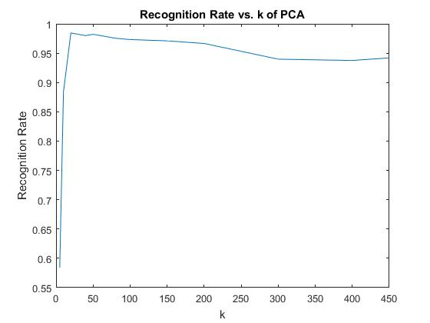
Right Half-Removed Normalized+Median+AHE Training Data
Applying Median Filter and Adaptive Histogram equalization (AHE) on the further increases the recognition rate.
The Iris is now better contrast enhanced and as a result the classification is slightly better.
Maximum Accuracy : 98.44%

Slide 21
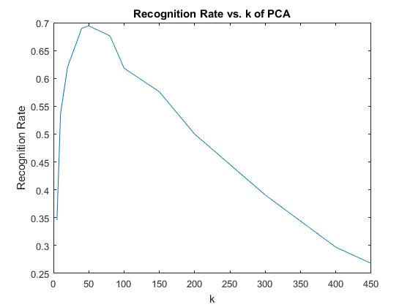
Median Filter + CLAHE on Training Data
Applying Median Filter and Adaptive Histogram equalization (AHE) on the decreases the recognition rate.
This is in contrast with Median + AHE in Normalized training data case as the unwanted features (predominantly the eyelashes) are much better enhanced than the Iris, further reducing the recognition rate.
Maximum Accuracy : 69.42%

Slide 22
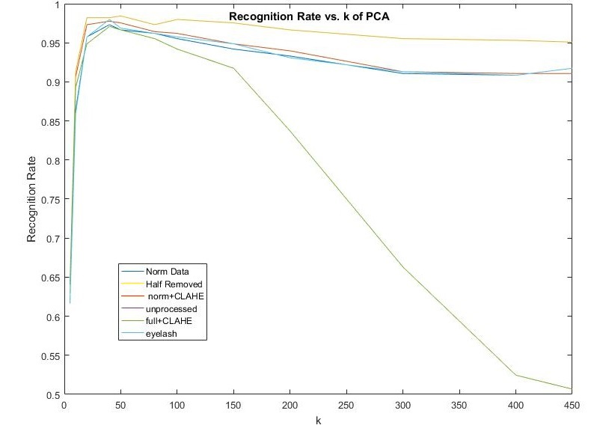
Our algorithm takes on an average 0.077 seconds to test an input against our training dataset.

Slide 23
References
Emad ul Haq, Q.; Javed, M.Y.; Sami ul Haq, Q., "Efficient and robust approach of iris recognition through Fisher Linear Discriminant Analysis method and Principal Component Analysis method," in Multitopic Conference, 2008. INMIC 2008. IEEE International ,pp.218-225, 23-24 Dec. 2008
“Principal Components Analysis Based Iris Recognition and Identification System”, E. Mattar, International Journal of Soft Computing and Engineering (IJSCE), ISSN: 2231-2307, Volume-3, Issue-2, May 2013.

Slide 24
“ There is no real ending.
It’s just the place where
you stop the story.”
-Frank Herbert

